Slide 1
Qualification
OT Code : M501
Qualification
Batch
B.Tech, CIVIL
2023
Address
Contact
Village Marh Kharayat
Pithoragarh, Uttarakand, Pin Code – 262501.
sandeepkharayat168@gmail.com
7669183335
Sandeep Singh Kharayat
Date of Birth
Blood Group
Gender
08-05-1995
Male

Slide 2
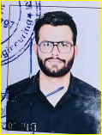
Qualification
OT Code : M502
Qualification
Batch
B.Tech, CIVIL
2023
Address
Contact
69/1, East Amber Talab,
Opp. Gandhibal Niketan,
Roorkee, Uttaranchal - Pin Code – 247667.
hardikarora31@gmail.com
9599432177
Hardik Arora
Date of Birth
Blood Group
Gender
11-12-1995
Male

Slide 3
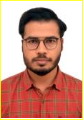
Qualification
OT Code : M503
Qualification
Batch
B.Tech, CIVIL
2023
Address
Contact
Near Shri Durga Ji Mandir, Subikhar Village,Bairouna, Deoria, Uttar Pradesh – 274001.
ies.anandtiwari@gmail.com
8700696377
Anand Kumar
Tiwari
Date of Birth
Blood Group
Gender
01-02-1996
Male

Slide 4
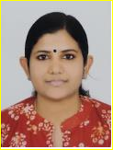
Qualification
OT Code : M504
Qualification
Batch
B.Tech, CIVIL
2023
Address
Contact
Sreevaikundam,
TC 8/807(2), TV Nagar, Thirumal P.O., Thiruvananthapuram, Kerala – 695006.
paru1996sreevaikundam@gmail.com
9207306810
PARVATHY A S
Date of Birth
Blood Group
Gender
03-12-1996
Female

Slide 5
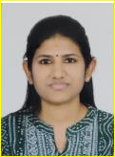
Qualification
OT Code : M505
Qualification
Batch
B.Tech, CIVIL
2023
Address
Contact
Sreevaikundam,
TC 8/807(2), TV Nagar, Thirumal P.O., Thiruvananthapuram, Kerala – 695006.
leku1996sreevaikundam@gmail.com
9207306812
LEKSHMI A S
Date of Birth
Blood Group
Gender
03-12-1996
Female

Slide 6
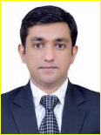
Qualification
OT Code : M506
Qualification
Batch
B.Tech, CIVIL
2023
Address
Contact
Flat No.602, Tower 3, Lodha Belmondo, Gahunje, Pune – 412101.
Vipul.goyal91@gmail.com
7385165702
VIPUL GOYAL
Date of Birth
Blood Group
Gender
06-07-1991
Male

Slide 7
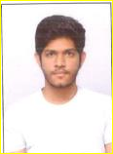
Qualification
OT Code : M507
Qualification
Batch
B.Tech, CIVIL
2023
Address
Contact
201, Dasarathi Apartment, Lecturer Street, Bhimavaram, Andhra Pradesh – 534202.
aravindraju5555@gmail.com
9959677889
DATLA ARAVIND RAJU
Date of Birth
Blood Group
Gender
21-06-1997
Male

Slide 8
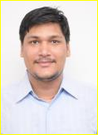
Qualification
OT Code : M508
Qualification
Batch
B.Tech, CIVIL
2023
Address
Contact
Q.NO.B-2, Sector-2, H.E.C. Colony,
Dhurwa, Ranchi, Jharkhand-834004.
vaishnavkumar2013@gmail.com
8512024020
VAISHNAV KUMAR
Date of Birth
Blood Group
Gender
31-03-1997
Male

Slide 9
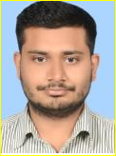
Qualification
OT Code : M509
Qualification
Batch
B.Tech, CIVIL
2023
Address
Contact
SM-31, Ambica Avas, Phase-I, Saidapur Hawkins, Bareilly, Uttar Pradesh - 243122
gaurav.agnihotri60@gmail.com
7985072996
AYUSH KUMAR AGNIHOTRI
Date of Birth
Blood Group
Gender
01-07-1997
Male

Slide 10
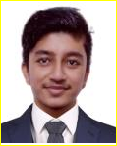
Qualification
OT Code : M510
Qualification
Batch
B.Tech, Civil
2023
Address
Contact
Villlage Balakote
Post Office Tharkote
Pithoragarh, Uttarakhand – 262530.
pwnrawal@gmail.com
9759384552
PAWAN RAWAL
Date of Birth
Blood Group
Gender
03-09-1997
Male

Slide 11
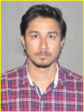
Qualification
OT Code : M511
Qualification
Batch
B.Tech, CIVIL
2023
Address
Contact
Village Richhi Post Punasa, District Khandwa, Madhya Pradesh – 450114.
Dewdavirendra@gmail.com
7077102207
VIRENDRA SINGH DEWDA
Date of Birth
Blood Group
Gender
06-07-1991
Male

Slide 12
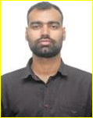
Qualification
OT Code : M512
Qualification
Batch
B.Tech, CIVIL
2023
Address
Contact
Village and Post Samogara, Kotwali Dehat, Mirzapur, Uttar Pradesh – 231001.
singhabhi97iitk@gmail.com
7309087233
ABHINAV KUMAR SINGH
Date of Birth
Blood Group
Gender
13-09-1997
Male

Slide 13
Qualification
OT Code : M513
Qualification
Batch
B.Tech, CIVIL
2023
Address
Contact
H.No.72, Udaybhanpur, Kolhua Bazaar, Maharaj Gunj, Jaunpur, Maharashtra – 222145.
singhshashwat451@gmail.com
9004669137
SINGH SHASWATH DINESH
Date of Birth
Blood Group
Gender
10-01-1996
Male

Slide 14
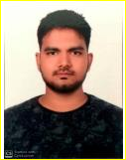
Qualification
OT Code : M514
Qualification
Batch
M.Tech, Geotechnical
2023
Address
Contact
Village Belwani, Post Mathela, Chandauli, Sakaldiha, Uttar Pradesh – 232109.
8127474428@mcrhrdi.in
8127474428
SAURABH PAL
Date of Birth
Blood Group
Gender
10-03-1995
Male

Slide 15
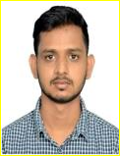
Qualification
OT Code : M515
Qualification
Batch
B.Tech, CIVIL
2023
Address
Contact
Village Karra Harrai Thana Deva, Barabanki, Uttar Pradesh – 225301.
sonu1573715@gmail.com
7236819148
SONU VERMA
Date of Birth
Blood Group
Gender
20-01-1996
Male

Slide 16
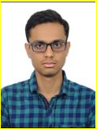
Qualification
OT Code : M516
Qualification
Batch
B.Tech, CIVIL
2023
Address
Contact
H.No.1054, Sec-4, Kurukshetra ,
Haryana - 136118
sudhirsahil108@gmail.com
9034249532
SUDHIR KUMAR
Date of Birth
Blood Group
Gender
11-08-1996
Male

Slide 17
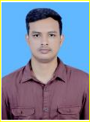
Qualification
OT Code : M517
Qualification
Batch
B.Tech, CIVIL
2023
Address
Contact
Village Koshdihara, Padrawan, Jamhore, Aurangabad,
Bihar – 824121.
avinash151296@gmail.com
7060334337
AVINASH KUMAR
Date of Birth
Blood Group
Gender
15-12-1996
Male

Slide 18
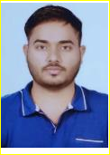
Qualification
OT Code : M518
Qualification
Batch
B.Tech, CIVIL
2023
Address
Contact
H.No.301, Vasundhara Colony, Saloda Mode, Gnagapur Coty – 322201.
akashmeena250@gmail.com
8302799547
AKASH MEENA
Date of Birth
Blood Group
Gender
25-08-1996
Male

Slide 19
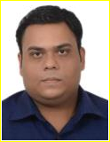
Qualification
OT Code : M519
Qualification
Batch
B.Tech, CIVIL
2023
Address
Contact
A-11, Shreeji Sankalp Residency,
Gortri Road, Vadodara,
Gujarat-390021
imvivek1128@gmail.com
9426688053
VIVEK KUMAR MEENA
Date of Birth
Blood Group
Gender
12-12-1996
Male

Slide 20
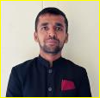
Qualification
OT Code : M520
Qualification
Batch
B.Tech, Mechanical
2023
Address
Contact
H.No.110, Village Kesri, Ambala, Haryana-13102.
garg1209377@gmail.com
9996661708
PANKAJ GARG
Date of Birth
Blood Group
Gender
15-09-1992
Male

Slide 21
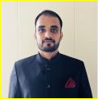
Qualification
OT Code : M521
Qualification
Batch
B.E, Mechanical
2023
Address
Contact
H.No.354, VPO, Gangana, Sonipat, Haryana-131302.
chahalvikas33@gmail.com
9035201002
VIKAS CHAHAL
Date of Birth
Blood Group
Gender
07-07-1994
Male

Slide 22
Qualification
OT Code : M521
Qualification
Batch
B.Tech, Mechanical
2023
Address
Contact
VOP Baghwas, Jaipur, Rajasthan-303603.
yravi274@gmail.com
8441060460
RAVI YADAV
Date of Birth
Blood Group
Gender
28-04-1997
Male

Slide 23
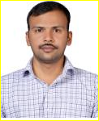
Qualification
OT Code : M523
Qualification
Batch
B.E, Mechanical
2023
Address
Contact
A5, Flat No.4, Ganga Village, Hadapsar, Pune, Maharashtra-411028
tushar9khatke@gmail.com
7972627482
KHATKE TUSHAR LALASO
Date of Birth
Blood Group
Gender
09-12-1994
Male

Slide 24
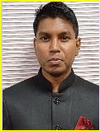
Qualification
OT Code : M524
Qualification
Batch
B.Tech, Mechanical
2023
Address
Contact
Saipuram Colony, Ward No.18, Katni, Madhya Pradesh-483501.
prajapatisanddep104@gmail.com
6261477497
SANDEEP PRAJAPATI
Date of Birth
Blood Group
Gender
10-09-1991
Male

Slide 25
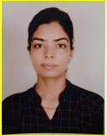
Qualification
OT Code : M525
Qualification
Batch
B.Tech, Eectrical and Electronics
2023
Address
Contact
Near New Bus Stand, Salasar Road, Sujangarh, Churu, Rajasthan-331507.
8118830662@mcrhrdi.in
8118830662
NEHA SAINI
Date of Birth
Blood Group
Gender
04-04-1995
Female

Slide 26
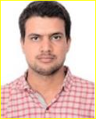
Qualification
OT Code : M526
Qualification
Batch
B.Tech, Electrical
2023
Address
Contact
Dhani Ahiran Ki, Post Rooppura, Sikar, Rajasthan-332719.
shrikrishan96@gmail.com
9912640824
SHRIKRISHAN YADAV
Date of Birth
Blood Group
Gender
18-08-1996
Male

Slide 27
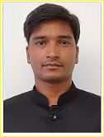
Qualification
OT Code : M527
Qualification
Batch
B.Tech, Electrical
2023
Address
Contact
17, Shankar Vihar, Jagatpura, Jaipur, Rajasthan-302017
8083368363@mcrhrdi.in
8083368363
NIKUNJ JINDAL
Date of Birth
Blood Group
Gender
15-09-1992
Male

Slide 28
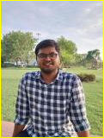
Qualification
OT Code : M528
Qualification
Batch
B.Tech, Electrical
2023
Address
Contact
Village Kanoon Goyan, Kannauj,
Uttar Pradesh-209725.
jaykumar961110@gmail.com
79850049003
JAY KUMAR
Date of Birth
Blood Group
Gender
04-02-1997
Male

Slide 29
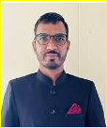
Qualification
OT Code : M529
Qualification
Batch
B.Tech, Electrical
2023
Address
Contact
Jodhpura, Udaipurwati, Jhunjhunu, Rajasthan-333801.
narpatsingh912@gmail.com
7763829089
NARPAT RAM MEENA
Date of Birth
Blood Group
Gender
05-02-1995
Male

Slide 30
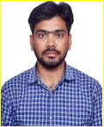
Qualification
OT Code : M530
Qualification
Batch
B.Tech, Electrical and Electronics
2023
Address
Contact
Barwara, Mahar
Khurd, Jaipur,
Rajasthan-303806.
bhoopendrameena98@gmail.com
9490992415
BHOOPENDRA SINGH MEENA
Date of Birth
Blood Group
Gender
08-01-1998
Male

Slide 31
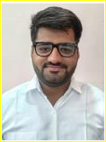
Qualification
OT Code : M531
Qualification
Batch
B.Tech, CIVIL
2023
Address
Contact
C12, Dalvi Colony, Guna, Madhya Pradesh-473001.
himanilshrivastava251@gmail.com
9713544284
HIMANIL SRIVASTAVA
Date of Birth
Blood Group
Gender
15-11-1995
Male

Slide 32
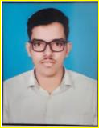
Qualification
OT Code : M532
Qualification
Batch
B.Tech, CIVIL
2023
Address
Contact
Dalmia Compound, Road No.4, Lakhibagh, Manpur, Gaya,
Bihar-823003.
keshavofficial28@gmail.com
8292826716
KESHAVANAND SINGH
Date of Birth
Blood Group
Gender
28-12-1998
Male

Slide 33
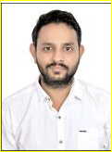
Qualification
OT Code : M533
Qualification
Batch
B.Tech, CIVIL
2023
Address
Contact
IC-2, 505, Essel Towers, MG Road, Gurugram, Haryana-122002.
8168794895@mcrhrdi.in
8168794895
GAUTAM AGGARWAL
Date of Birth
Blood Group
Gender
11-01-1997
Male

Slide 34
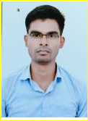
Qualification
OT Code : M534
Qualification
Batch
B.Tech, CIVIL
2023
Address
Contact
H.No.110, Village Kesri, Ambala, Haryana-133102.
kumarnilmani54@gmail.com
9852262814
NILMANI KUMAR
Date of Birth
Blood Group
Gender
14-02-1997
Male

